Slide 1

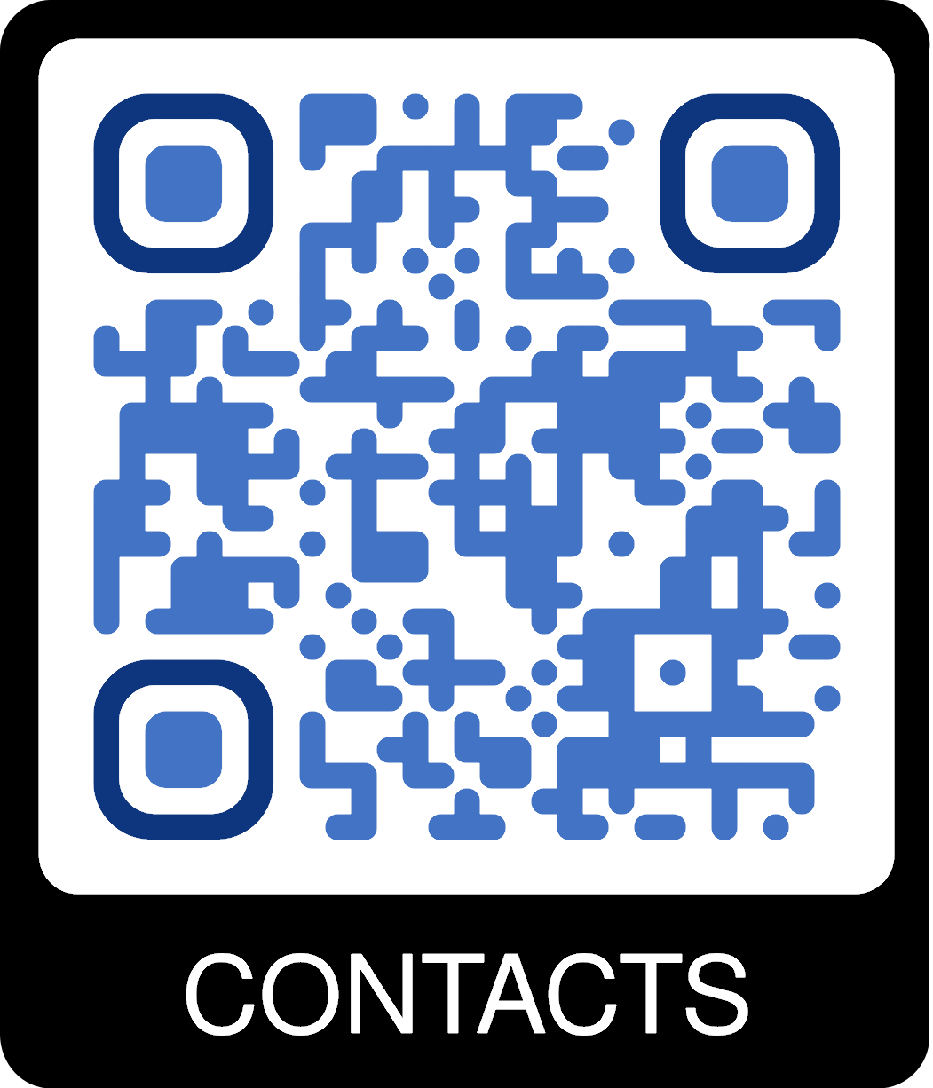
Voluntary help
for Sandnessjøen high school
Computer Science
Free topic
Math
Physics
Self-development​
Life Understanding
Wellbeing
Table-tennis

